Slide 1
Alpha Zeta Omega
Pharmaceutical
Fraternity

Slide 2
Alpha Zeta Omega is…
A pharmaceutical fraternity composed of Pharmacists and Undergraduates in pharmacy selected on the basis of character, fellowship, and scholarship.
Jonathan McLachlan
Supreme Directorum
rxjmak@gmail.com
Nicole Saracino
Supreme 1st Sub-Directorum
nsaracino4@gmail.com
Adam Schweitzer
Supreme 2nd Sub-Directorum
azoadam@gmail.com

Slide 3
What is a Fraternity?
Intimate association of individuals having similar interests, ideals, and objectives
Voluntary bond
Opportunity for professional advancement within one’s chosen field
Allows for growth and development of young professionals
Encourages scholastic achievement

Slide 4
History

Slide 5
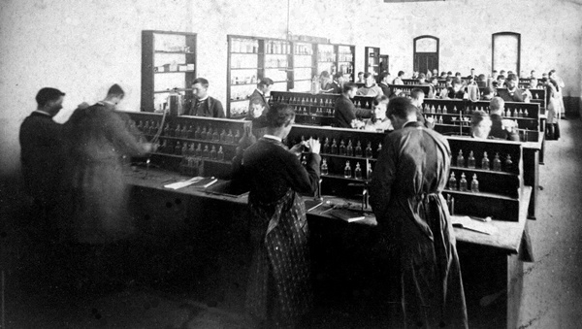
Alpha Zeta Omega History
Founded in 1919 at the Philadelphia College of Pharmacy (Now known as Philadelphia University of the Sciences)
Original goal set out by the 13 founding fathers: 100% graduation of all members
Founded on the basis of peace, friendship, and brotherly love

Slide 6
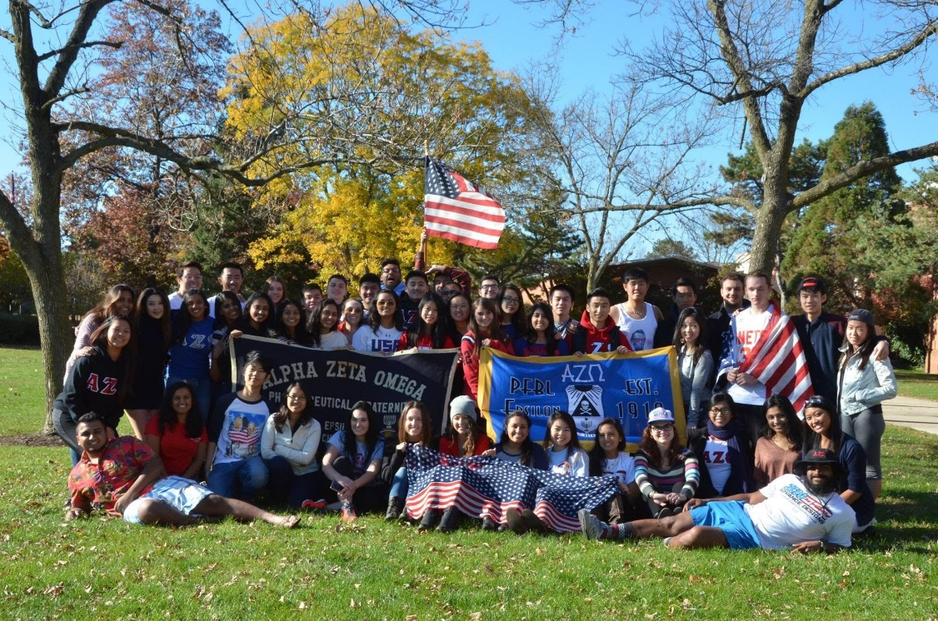
Alpha Zeta Omega Facts
46 Chapters founded since 1919
Co-Ed Professional Fraternity
Chapters can be made up of Undergraduate membership, Alumni membership or be both (mixed)

Slide 7
Organizational Structure

Slide 8
Organizational Structure
Supreme Council Member at Large
Supreme Deputy
Alumni Chapter Directorum
Appointed Officers
Elected Officers
1st Sub-Directorum
Board of Justices
Alumni Frater
Chapter Committees
Chapter Officers
You Are Here!
Supreme Directorum
Supreme Signare & Supreme Excheque
Candidate
2nd Sub-Directorum
Chapter Committees
Chapter Officers
Collegiate Chapter Directorum
Collegiate Frater
Collegiate Chapter Advisors

Slide 9
Mission, Vision & Values

Slide 10
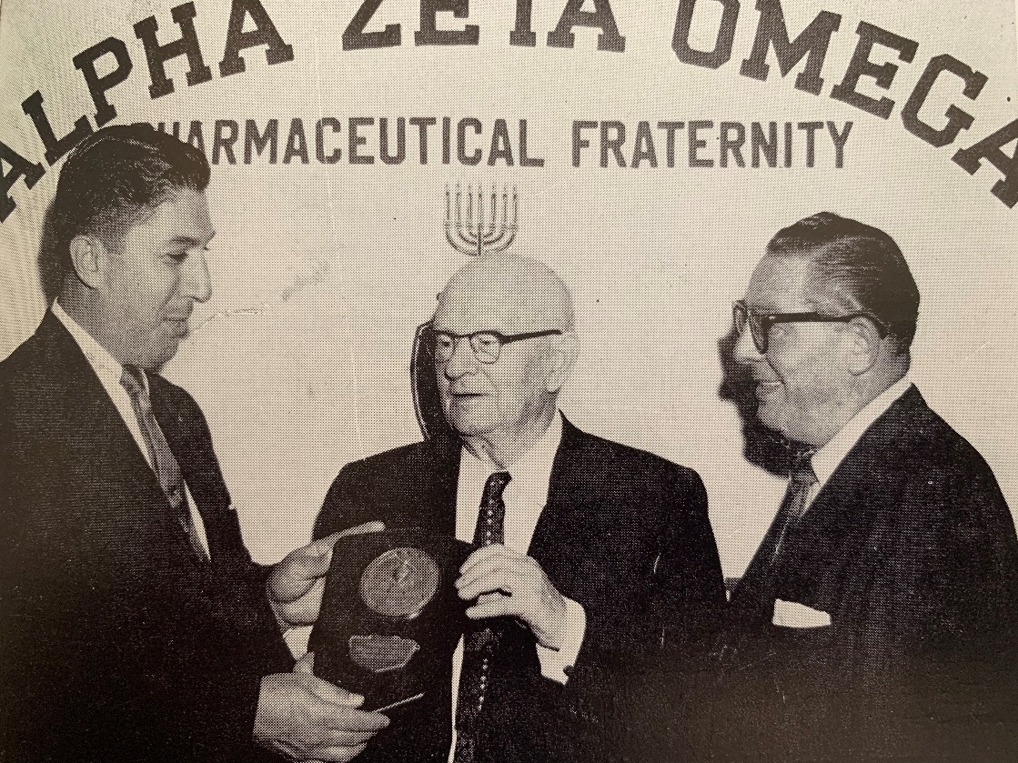
Alpha Zeta Omega Mission
Promote the profession of pharmacy
Develop high standards of scholarship
Instill a spirit of fellowship

Slide 11
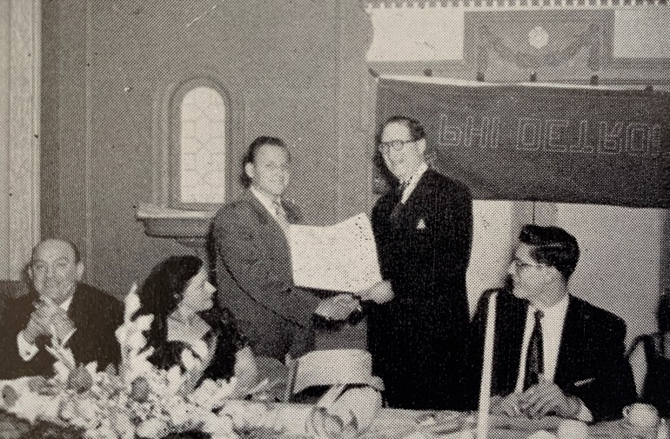
Alpha Zeta Omega Vision
Alpha Zeta Omega is:
Is recognized for empowering members to be leaders
Is a diverse and committed community of students and alumni
Has a national network of both collegiate and alumni chapters
Offers programs and experiences that support members across all stages of their lives both professionally and personally
Enables leaders to actively engage in the pharmacy profession

Slide 12
Alpha Zeta Omega Values
Academic Excellence
Strive for 100% of graduation of all members
We believe that education is essential to success in the profession of pharmacy
We are dedicated to scholastic excellence
We are committed to the continuation of professional development
We create relationships based on trust, responsiveness and mentorship
We forge deep and lasting bonds with one another
We remain committed to one another throughout our lives
Service
Support each other and the community
We hold members accountable to high standards of professional excellence
We build strongly our individual character
We are passionate about contributing to the greater good
Members for Life
We are committed to each other and the Fraternity well beyond undergraduate years

Slide 13
Benefits of ΑΖΩ

Slide 14
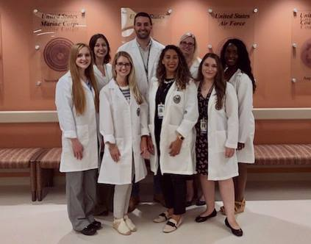
Professional Fraternity Benefits
Promotion of your chosen profession
Pharmacy involvement & advocacy
Scholarships
Awards
Community service projects
Social activities
Lifelong friendships

Slide 15
Alpha Zeta Omega Specifics
Chapter By-Laws & Constitution
All Chapters must follow all Alpha Zeta Omega rules and regulations set for in the constitution
National and Regional Conventions
Host 2 annual conventions per year
Most recent convention: Aruba
Next conventions: Sarasota, FL & Louisville, KY
10 Supreme (National) Board Officers
Official publication: The AZOan
Quarterly publication: The Apothecary

Slide 16
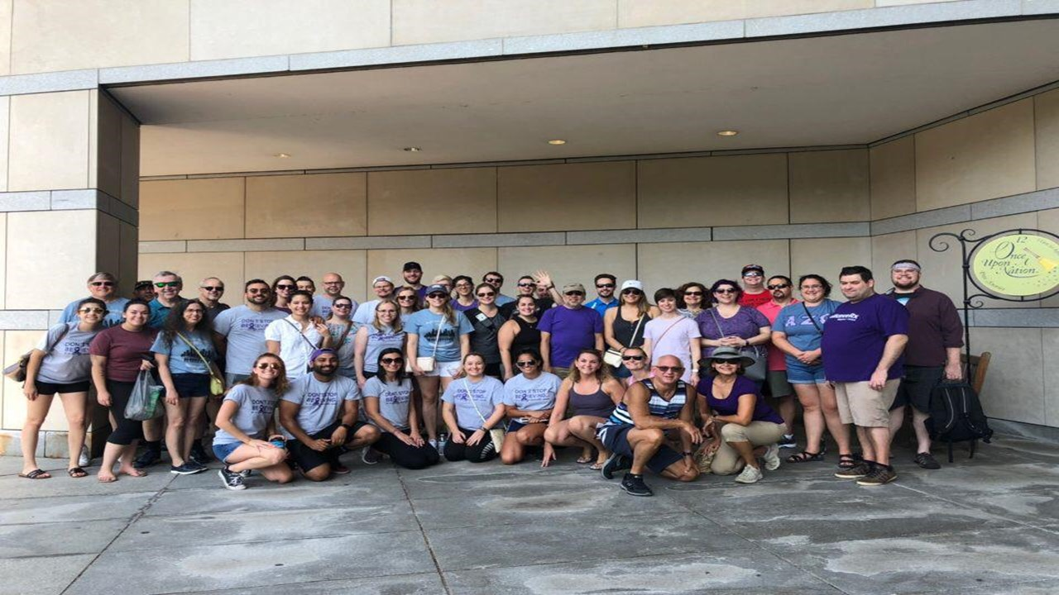
National Philanthropy
Lustgarten Foundation

Slide 17
Additional Philanthropic Efforts
Dance Marathon- Embrace the Children’s Foundation
Blood Drives- American Red Cross
Astra Zeneca Hope Lodge- National Cancer Society
Walk to End Alzheimer's- Alzheimer's Association
Parkinson's Unity Walk- The American Parkinson's Disease Association
World AIDS Day- World Health Organization
Relay for Life- National Cancer Society
Adopt-a-Road-
AHA Heart Walk- American Heart Association
Race for the Cure- Susan G. Komen Foundation
Nick K 5K

Slide 18
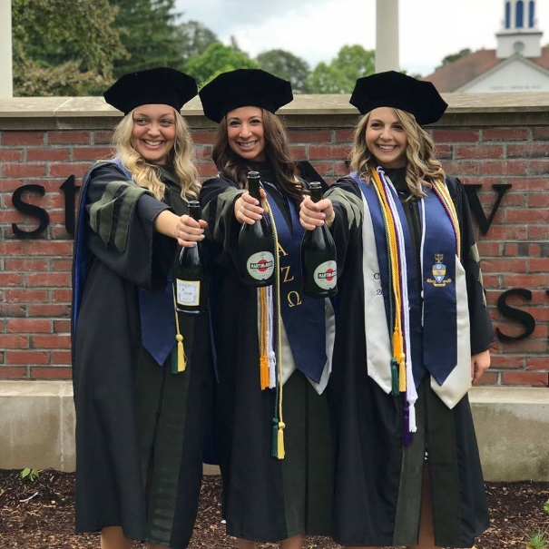
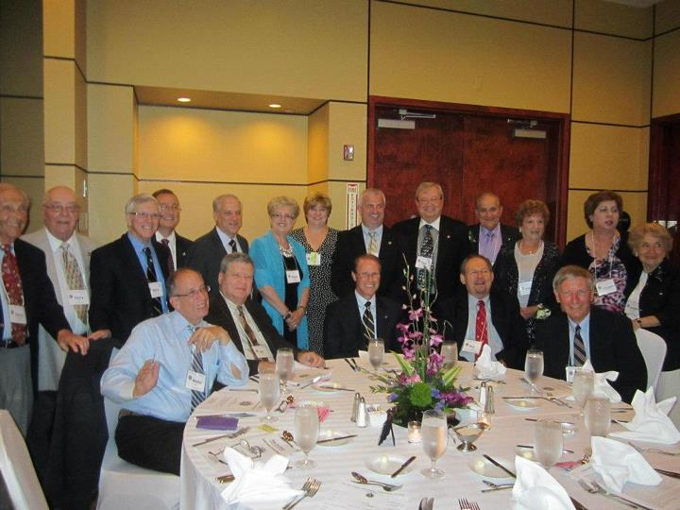
Professional Events
Free Live Continuing Education Courses
Mock Interview Workshops
Assistance with preparation for Mid-Year Conference
Mentorship Program
Chapter Formals
Resume, CV, & Cover Letter Editing

Slide 19
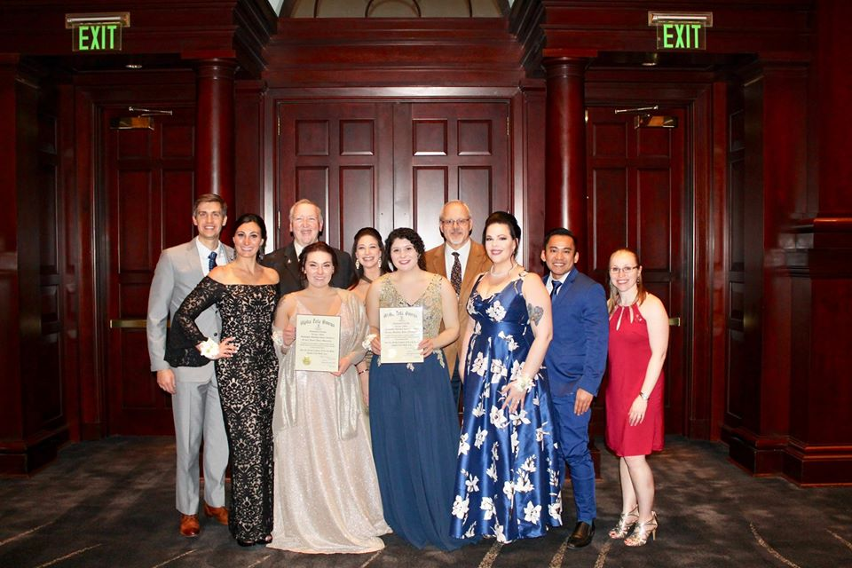
Awards and Scholarships
The Alpha Zeta Omega scholarship and awards program supports members for their dynamic leadership, service, chapter excellence and financial need.
E.G. Sless Scholarship
Jeff Levy Scholarship
Jay Pollock Scholarship
Sandra J. Williams Scholarship
Ernie Jacobson Scholarship
E.G. Sless Graduate Award
Simon Sless Undergraduate Award
Community Service Award
Meritorious Award
Achievement Award
Order of the Double Star

Slide 20
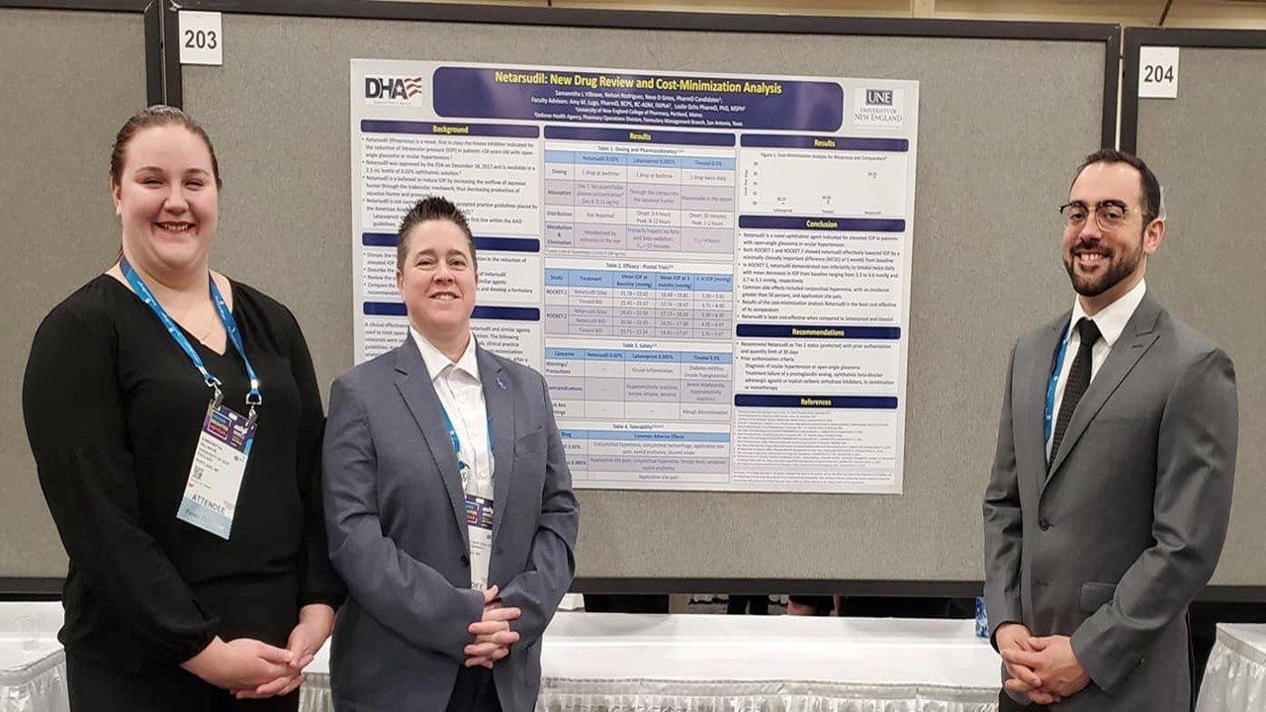
Advocacy
Alpha Zeta Omega supports the profession of Pharmacy through their Advocacy program as well as by passing yearly National Resolutions in which Alpha Zeta Omega takes a stance on current pharmaceutical topics. The Advocacy Committee promotes efforts on bringing awareness to issues within the profession of pharmacy, guides the Fraternity's national efforts around federal pharmacy bills, and assists Chapters on their local advocacy initiatives.
Participation in local legislature days
Drug buy-back programs
Opioid epidemic outreach
Promotion of pharmacy initiatives
Participation in community health fair events

Slide 21
Professional Resources
Alpha Zeta Omega hold its members to a high standard of scholastic responsibility
We support professional development through our Mentorship Program
CV/Resume workshops
Cover letter editing
Assistance with preparing for Mid Year
We offer at least 8 credits of Live Continuing Education through Webinars throughout each year
2020-2021 we are offering 16 Live CE events
4 additional Continuing Education Credits are offered Live at our Bi-annual Conventions

Slide 22
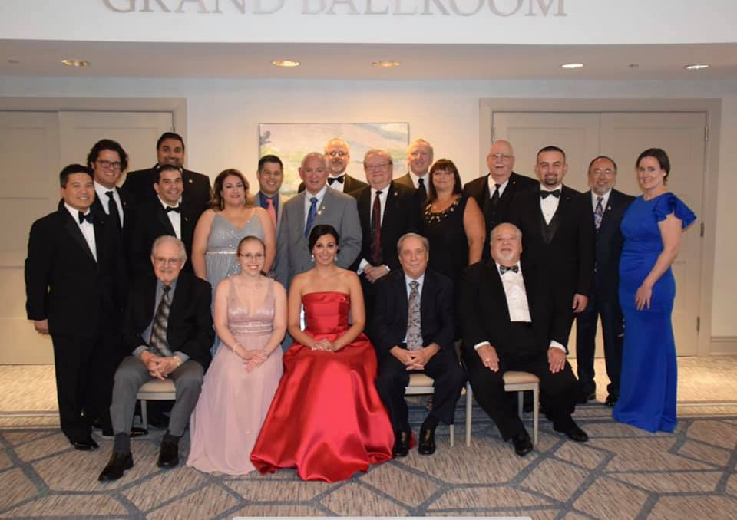
Leadership Opportunities
National
Appointed Officer
Committee Member
Committee Chair
Elected Officer
Chapter
Appointed Officer
Committee Member
Elected Officer

Slide 23
Convention
National meeting held twice per year
Serves as an opportunity for a reunion with other Fraters, as well as a place to conduct Alpha Zeta Omega’s business
Winter Convention is held at the beginning of January (4 days long)
Continuing Education Seminar
Professional Mentorship Program
Formal Banquet held in honor of the chosen Supreme Undergraduate Award recipient
Fraternity Meeting
Summer Convention is held in mid July (5 days long)
Continuing Education Seminar
Fraternal Mentorship Program
Resolutions/Pharmaceutical Advocacy Meeting
Formal Banquet held in honor of either a Meritorious Award Recipient or an Achievement Award Recipient
Formal Banquet held for National Officer Installation
Fraternity Meeting

Slide 24
Expectations of Chapters

Slide 25
Expectations of Chapters
Prompt payment of Chapter tax, initiation and activity fees with accompanying membership information
Participation of all members in the following each year:
Philanthropic events
Professional events
Fundraising for National Project (Lustgarten Foundation)
Pharmacy Advocacy event
Chapter meetings at least 2x per month with minutes sent monthly to the Supreme Signare and treasurer reports sent monthly to the Supreme Excheque
Recommended attendance at National meetings
1 financial contribution to the E.G. Sless scholarship fund
Submission of 3 newsletters per year to update the Fraternity on the Chapter’s doings
1 submission to the AZOan (National publication)

Slide 26
Rushing Alpha Zeta Omega
Process of obtaining new members
Allows prospective members the opportunity to learn about AZO before making a decision to join
Allows Fraters of AZO to get to know the prospective members and decide if they share similar goals
Rushing and orientation periods are campus specific

Slide 27
What is Orientation?
Educational learning period where you learn:
History
Rituals
Ideals
Tentative membership period where you pledge your loyalty to the fraternity
Fosters devotion to the fraternity
Joining a group that will help with professional and personal growth
Experience the true meaning of “peace, friendship, and brotherly love” with:
Fellow members
Older fraternity members

Slide 28
Joining ΑΖΩ
Alpha Zeta Omega promotes association, cooperation, and friendship
These learned ideals develop during a Candidate Education period
Learning the rituals and history of the Fraternity
Strengthens commitment and appreciation of the fraternity
Potential members should be prepared to work for the betterment and advancement of the Fraternity and pharmacy
Potential members should be prepared to hold leadership roles, serve the community, and promote pharmacy advocacy initiatives

Slide 29
Hazing
Alpha Zeta Omega National Pharmaceutical Fraternity does not condone physical or mental (emotional) hazing of any kind, by any definition.
Alpha Zeta Omega does not pledge, but rather hosts a probationary period in which candidates learn about the history, ideals, and values of the Fraternity
This orientation period is meant to be educational and promote community service, personal growth and professional development
ANY individual who does not follow Alpha Zeta Omega’s strict anti-hazing policy will be subject to suspension from the organization

Slide 30
10 Reasons to join ΑΖΩ

Slide 31
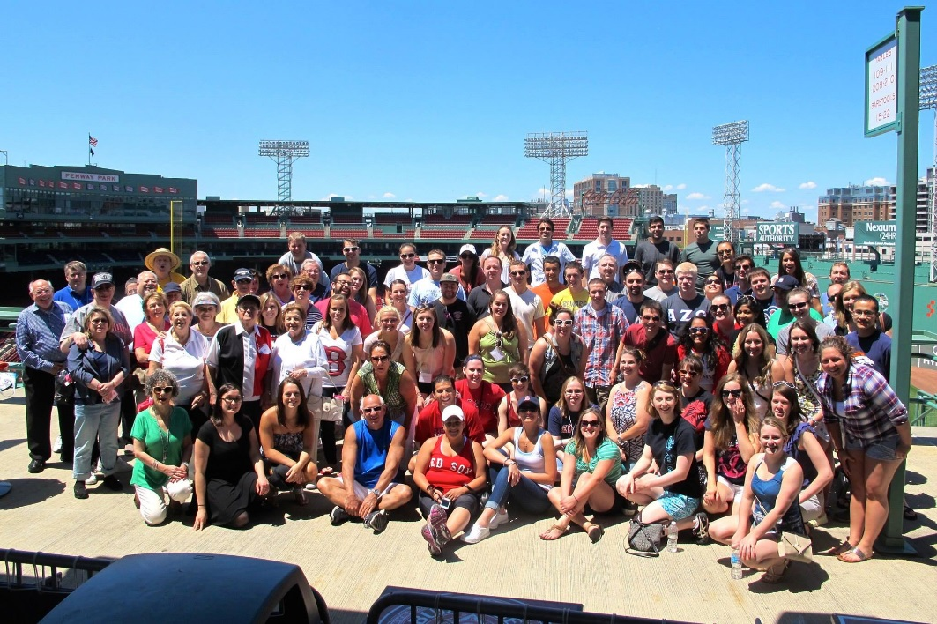
10. Promote the profession of Pharmacy
9. Networking opportunities
8. Educational growth and experiences
7. Scholarships and Awards
6. Social gatherings

Slide 32
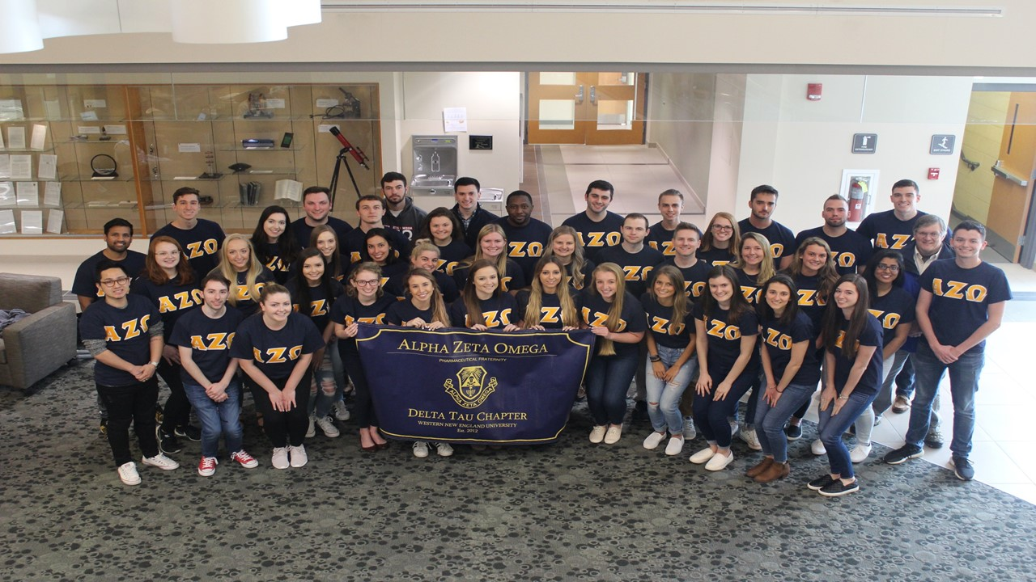
5. Philanthropic opportunities
4. Professional growth and leadership
3. Being a part of history
2. Life-long friendships
1. Discovering the true meaning of peace, friendship, and brotherly love

Slide 33
For more information, visit:
AZO.org

